Slide 1

Employee Performance & Attrition Analysis
Uncovering workforce turnover patterns through data-driven insights

Slide 2

Project Overview
Objective
Methodology
Analyze employee performance and attrition patterns to identify key turnover drivers
Python for data cleaning
SQL for analytical queries
Power BI for visualization

Slide 3
Dataset at a Glance
1,470
35
0
Total Records
Data Points
Missing Values
Employee profiles analyzed
Features per employee
Complete data quality
Demographics
Work Details
Age, Gender, Education, Marital Status
Department, Job Role, Years at Company, Overtime
Compensation
Performance
Monthly Income, Job Level, Salary Range
Ratings, Job Satisfaction, Environment Satisfaction

Slide 4
Data Preparation Journey
01
02
03
Data Loading
Quality Check
Standardization
1,470 records loaded and inspected using pandas
Verified no missing or duplicate values
Renamed columns for clarity and consistency
04
05
Primary Key Creation
Database Integration
Added unique Employee_ID column
Clean dataset loaded into MySQL

Slide 5
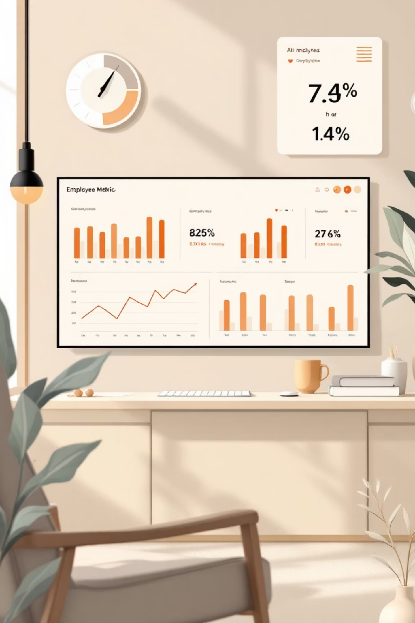
16.12%
Overall Attrition Rate
237 employees left out of 1,470 total workforce

Slide 6
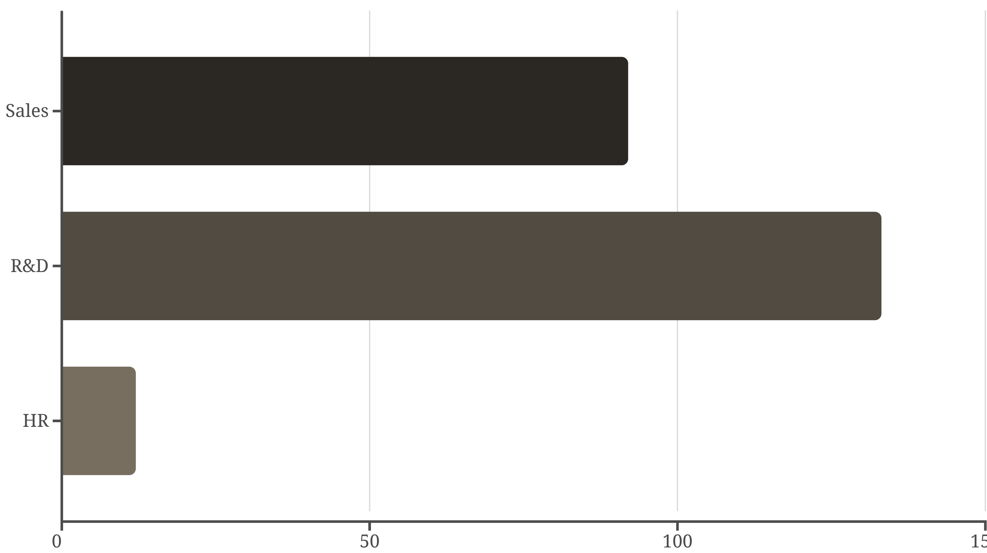
Attrition by Department
Sales department shows highest attrition rates, requiring immediate attention

Slide 7

Critical Attrition Drivers
Overtime Impact
Salary Correlation
Employees working overtime show significantly higher attrition rates
Lower salary ranges directly correlate with increased turnover
Early Tenure Risk
Employees with 0–3 years experience leave most frequently

Slide 8
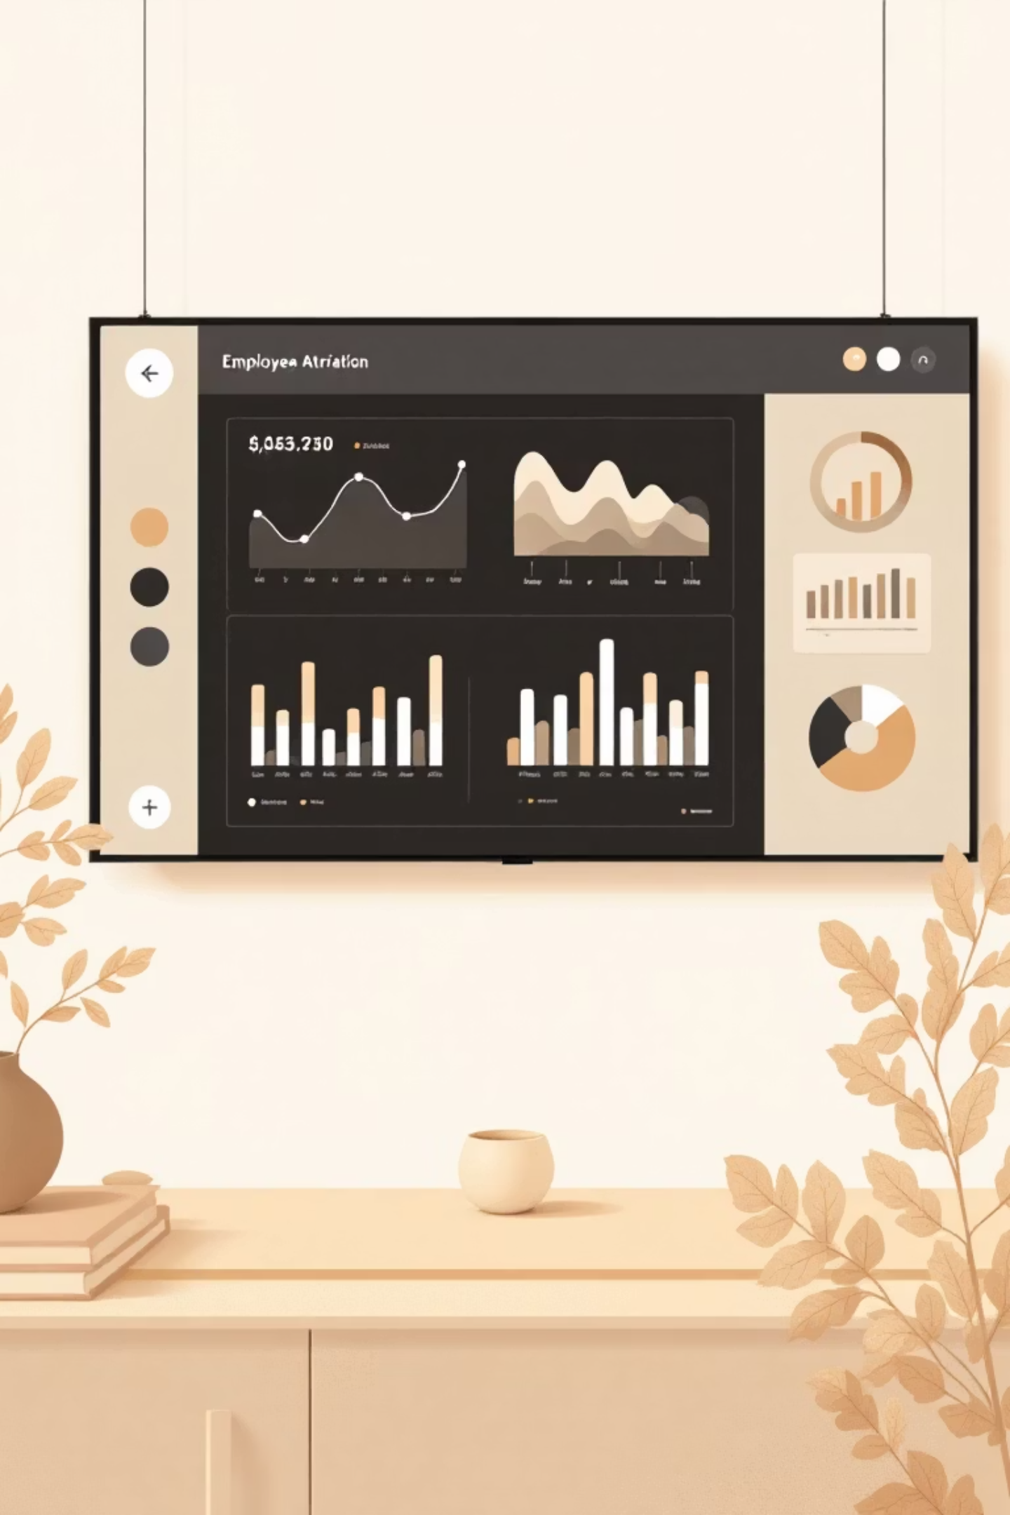
Power BI Dashboard Insights
Key Metrics
Top Factors
Visual Analysis
Total Employees: 1,470
Sales department
Interactive filters
Overtime workload
Trend identification
Employees Left: 237
Low salary bands
Pattern recognition
Attrition Rate: 16%

Slide 9

Strategic Recommendations
Early Tenure Retention
Manage Overtime
Improve Compensation
Develop mentorship and engagement programs for new hires under 3 years
Balance workloads and monitor burnout risks across departments
Raise lower salary bands to reduce financial-driven attrition
Enhance Work Environment
Recognize Performance
Invest in satisfaction surveys and well-being initiatives
Reward consistent performers to improve engagement

Slide 10




Next Steps
Implement Programs
Launch retention initiatives for high-risk groups
Monitor Progress
Track attrition metrics quarterly
Continuous Improvement
Refine strategies based on results

